Slide 1
Rockbuster Stealth LLC
Heather Visentin

Slide 2
Introduction
Rockbuster Stealth LLC is a movie rental company that used to have stores around the world. Due to stiff competition from streaming services, Rockbuster is planning to use its existing licenses to launch an online video rental service in order to stay competitive. Along with the business intelligence department, we were tasked to help with the launch strategy.

Slide 3
Key Questions and Objectives
Which movies contributed the most/least to revenue gain?
What was the average rental duration for all videos?
Which countries are Rockbuster customers based in?
Where are customers with a high lifetime value based?
Do sales figured vary between geographic regions?

Slide 4
Data Overview
 | Min | Max | Average
Rental Rate | 0.99 | 4.99 | 2.98
Rental Duration | 3 | 7 | 4.99
Length | 46 | 185 | 115.27
Replacement Cost | 9.99 | 29.99 | 19.98
Release Year: 2006
Languages: English
Number of Movies: 1000
Modal Rating: PG-13
Stores in: Canada and Australia
Number of Customers: 599

Slide 5
Which movies contributed most and least to revenue gain?

Slide 6
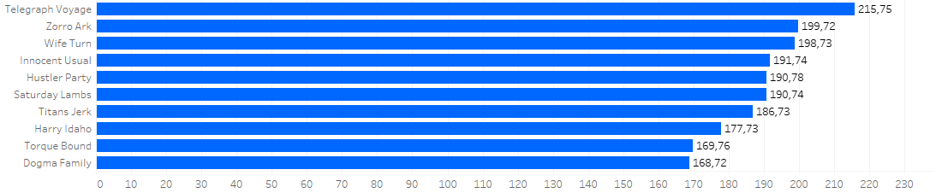
Top 10 movies
Movie Title
Revenue

Slide 7
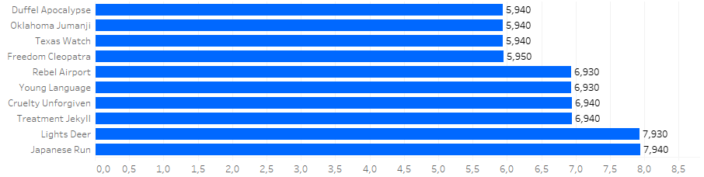
Bottom 10 movies
Movie Title
Revenue

Slide 8
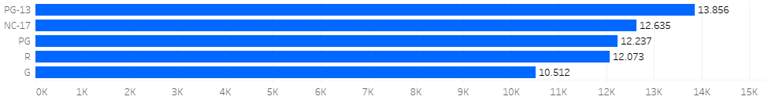
Top Ratings for Revenue
Rating
Revenue
PG-13 is the rating category with the highest revenue as seen above but it is also worth noting that it is the rating category with the most movies as well.
Number of Movies per Rating
PG-13: 223
NC-17: 210
R: 195
PG: 194
G: 178

Slide 9
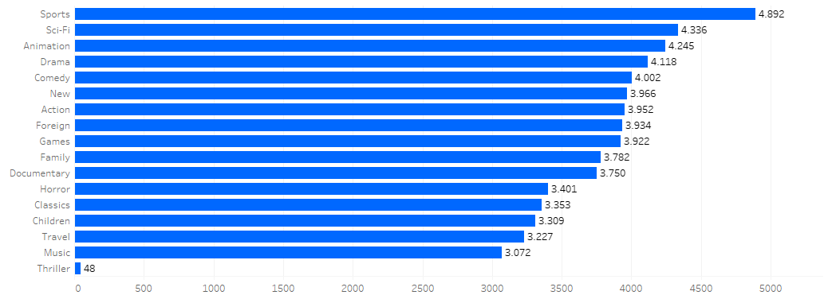
Top Genre for Revenue
Genre
Sports is the genre category with the most films in it. Thriller is the genre category with the least films in it. This is worth noting as it could explain why sports has the largest revenue.
Revenue
Number of Movies per Genre
Sports: 74
Foreign: 73
Family: 68
Documentary: 68
Animation: 66
Action: 64
New: 63
Drama: 62
Sci-Fi: 61
Games: 61
Children: 60
Comedy: 58
Travel: 57
Classics: 57
Horror: 56
Music: 51
Thriller: 1

Slide 10
Summary
The top revenue earning movies are Telegraph voyage, Zorro Ark and Wife turn.
PG-13 is the top revenue earing rating category followed by NC-17. These rating categories also have the most movies.
Sports, Sci-Fi and Animation are the top three revenue earning genres. Sports has the largest amount of movies within its genre. Both Sci-Fi and Animation were not in the top three for amount of movies.

Slide 11
Which countries are Rockbuster customers based in?

Slide 12
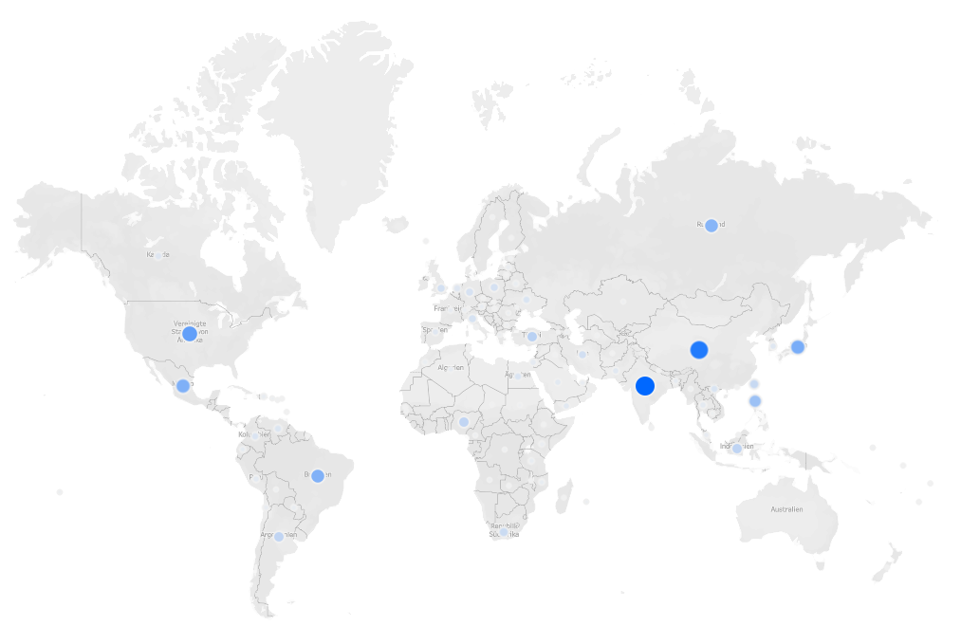
Top 10 Countries
Country | Number of Customers | Total Revenue
India | 60 | 6034.78
China | 53 | 5251.03
United States | 36 | 3685.31
Japan | 31 | 3122.51
Mexico | 30 | 2984.82
Brazil | 28 | 2919.19
Russian Federation | 28 | 2765.62
Philippines | 20 | 2219.70
Turkey | 15 | 1498.49
Indonesia | 14 | 1352.69

Slide 13
Top 10 Cities within Top 10 Countries
Country | City | Number of Customers
United States | Aurora | 2
Mexico | Acua | 1
United States | Citrus Heights | 1
Japan | Iwaki | 1
India | Ambattur | 1
China | Shanwei | 1
Brazil | So Leopoldo | 1
Russian Federation | Teboksary | 1
China | Tianjin | 1
Indonesia | Cianjur | 1

Slide 14
Summary
Rockbusted customers are based primarily in India and China.
These countries are also the top revenue earning countries for Rockbuster.

Slide 15
Where are customers with a high lifetime value based?

Slide 16
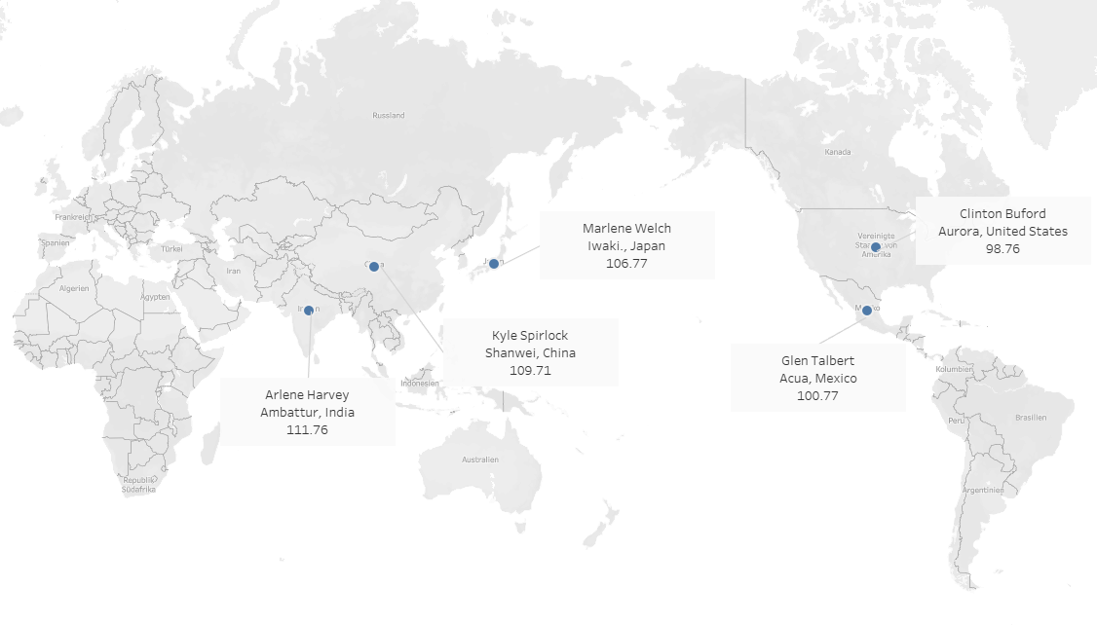
Top 5 Customers
The top 5 customers with the largest lifetime value are based in India, China, Japan, Mexico and the United States.

Slide 17
Do sales figures vary between geographic regions?

Slide 18
Revenue by Region
Oceania
576.62
South America
7141.25
Africa
6406.85
Half of the global revenue is coming from Asia. The rest of the revenue is fairly evenly split between the other regions with the exception of Oceania which has very little.
North America
8044.76
Europe
8504.78
Asia
30,637.78

Slide 19
Recommendations
Focus on adding inventory to the top performing genres: Sports, Sci-Fi, Animation, Drama and Comedy. Less focus should be given to Music, Travel, Childrens and Classics. Thriller would need more data before making a recommendation but the revenue per movie is relatively low so be cautious with adding too much invertory.
PG-13 and NC-17 are the top performing ratings. I would advise the inventory to focus in on these rating groups.
Asia is the strong leader for customer base, I would investing resources into this market.
I would recommend also investing into research for the other regions, to determine the best way to improve revenue in those regions. Specifically the Oceania region.

Slide 20
Thank you
Heather Visentin

